Slide 1
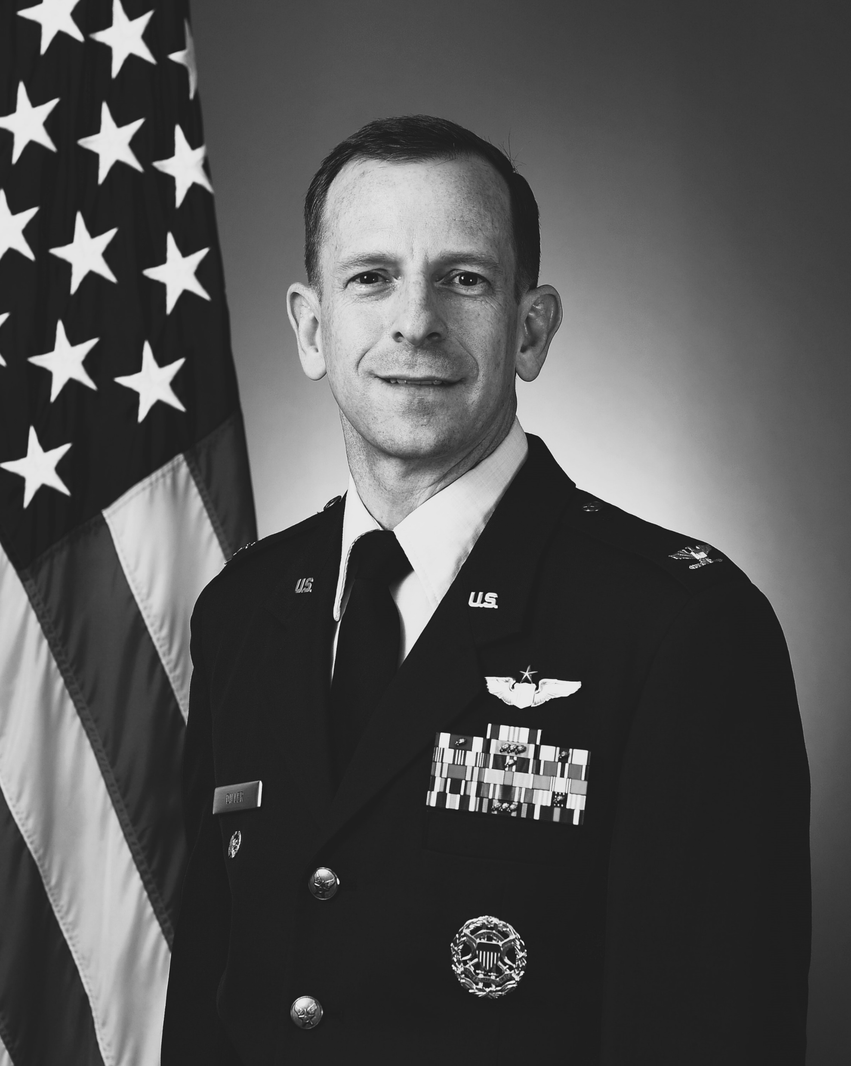
Col Nathan Diller Director AFWERX U.S Air Force
Defense and the commercial aviation revolution

